Slide 1

KPD 4015 APPLICATION BUG FIXING
PEMBAHAGIAN TUGASAN KUMPULAN
TEORI

Slide 2
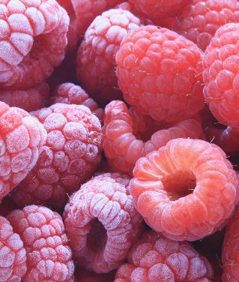


KUMPULAN 1
1.Wani
2. Tengku Adam
Topik :
Level of qualified severity such as:
• Critical
• High
• Low
• Blocker/show stopper
• Trivial

Slide 3
KUMPULAN 2
Ahmad
Nasrullah
TOPIK:
Error reproduce procedure

Slide 4
KUMPULAN 3
- Ain Maisarah
Aisyman
Topik :
Types of error triggered environment such as:
Hardware configuration
Software configuration
Network configuration

Slide 5
KUMPULAN 4
- Amir
- Aleya hani
Topik :
Types of unexpected user action such as:
• Unexpected data input
• Multiple user attempt
• Unexpected navigation pattern

Slide 6
KUMPULAN 5
- Ayepp
- Syahmi
Topik :
Types of error impact such as:
• Data lost
• System crash
• System unresponsive
• System malfunction

Slide 7
KUMPULAN 6
- Nabil
- Safiah
- Aniq
Topik :
Debugging procedure
Purpose of custom error page

Slide 8
KUMPULAN 7
-Adam Zaffri
-Nazri
Topik :
Types of custom error page such as:
• Under maintenance
• File not found //404
• Network lost//505

Slide 9
KUMPULAN 8
- Amirusyafi
- Sufi
Topik :
Debugging tools
Turnaround time

Slide 10
KUMPULAN 9
- Aliff
- Syafiq
- Alimin
Topik :
Types of testing such as:
Functional test
File test
Data integrity test

Slide 11

Tugasan
Hasilkan laporan penerangan mengenai sub topik mengikut kumpulan masing-masing.
Gunakan Microsoft powerpoint/canva mengikut kreativiti masing-masing
Laporan penerangan mesti mempunyai gambarajah dan contoh.
Boleh rujuk W3School dan rujukan internet yang lain.

Slide 12

The way to get started is to quit talking and begin doing.
Walt Disney

